Slide 1
GARDEN TOOL IN COMPUTER VISION
Authors:
Owor Wilbroad
Presented by -
Owor Wilbroad
Affiliation: Makerere University
Uganda

Slide 2
Contents of Presentation
Introduction
Annotation & Cropping
Image Shape Analysis
Class Image Display
Feature Extraction Using Color Histogram
Class Distribution
Data Splitting and Normalization
Classification and Results Interpretation
Data Augmentation
Loss and AUC Curve
Results Discussion
Github and Youtube Links

Slide 3
Introduction
In this examination we were expected do develop a garden monitoring tool that could be able to identify/classify three crops and grass. The project meets the needs as per the assignment and more details will be shared in the forthcoming slides.

Slide 4
Annotation and Cropping
Here upon image extraction from the Video we were able to annotate the images to xml files then cropped each image and then categorically classified them into three crop classes namely; Bananas, Maize, Cassava and then a class for grass was added as well.

Slide 5
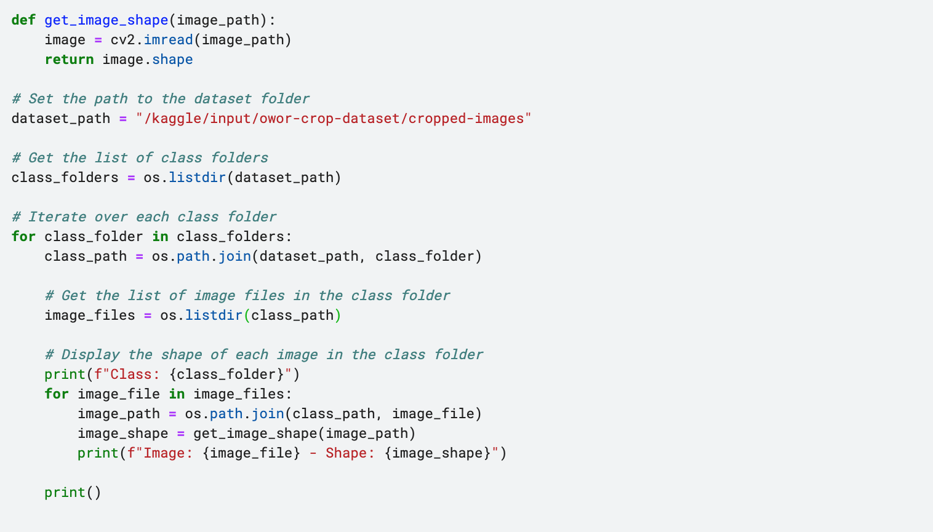
Image Shape Analysis
In image shape analysis here we focus on image shape analysis to help understand how to handle feature extraction.

Slide 6
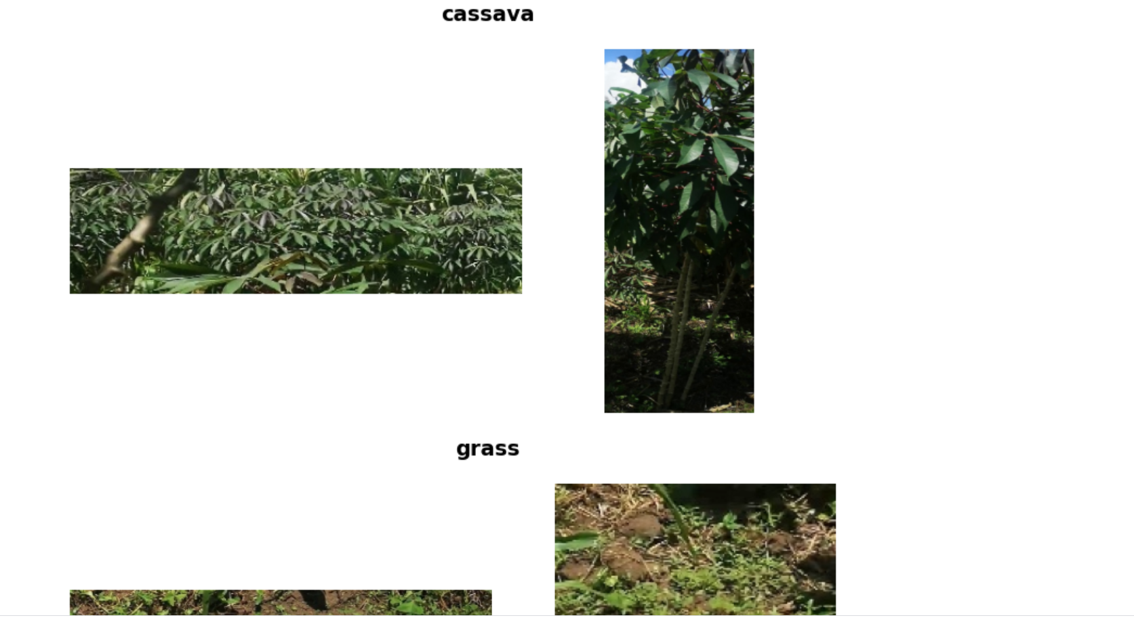
Class Image Display
Here we focus at displaying a few images from each of the classes as shown below;

Slide 7
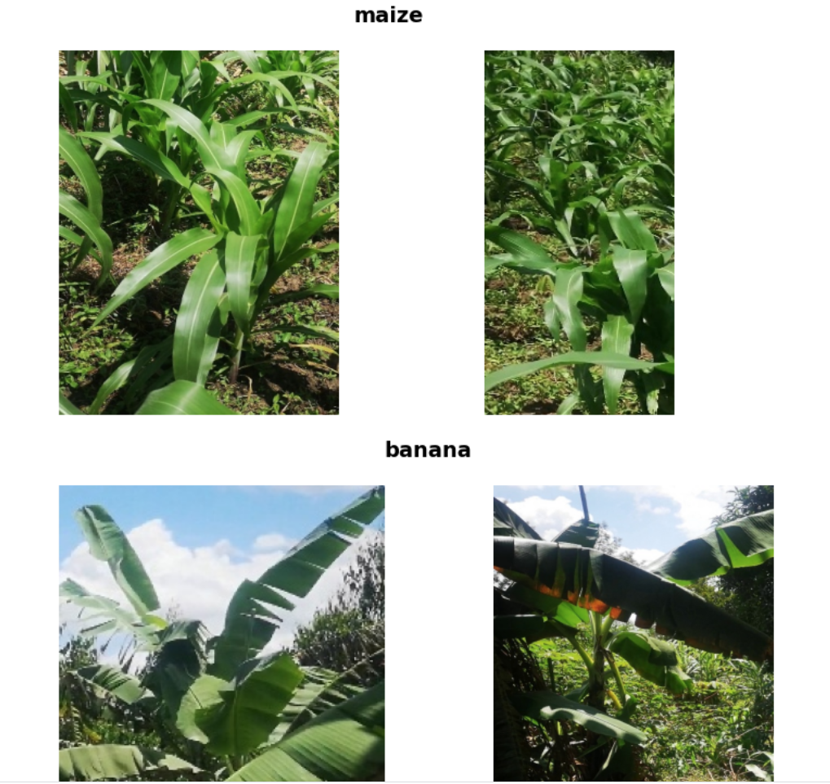
Class Image Display

Slide 8
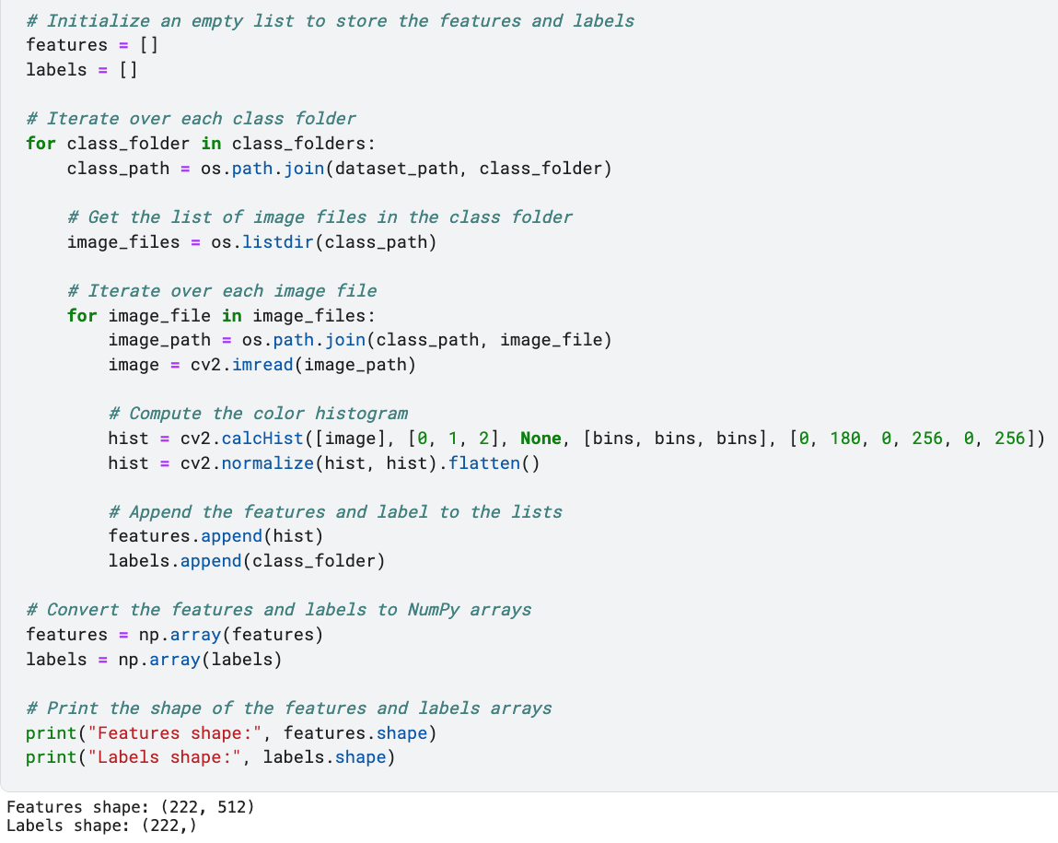
Feature Extraction Using Color Histogram
Here we perform feature extraction using Color Histogram as shown below;

Slide 9
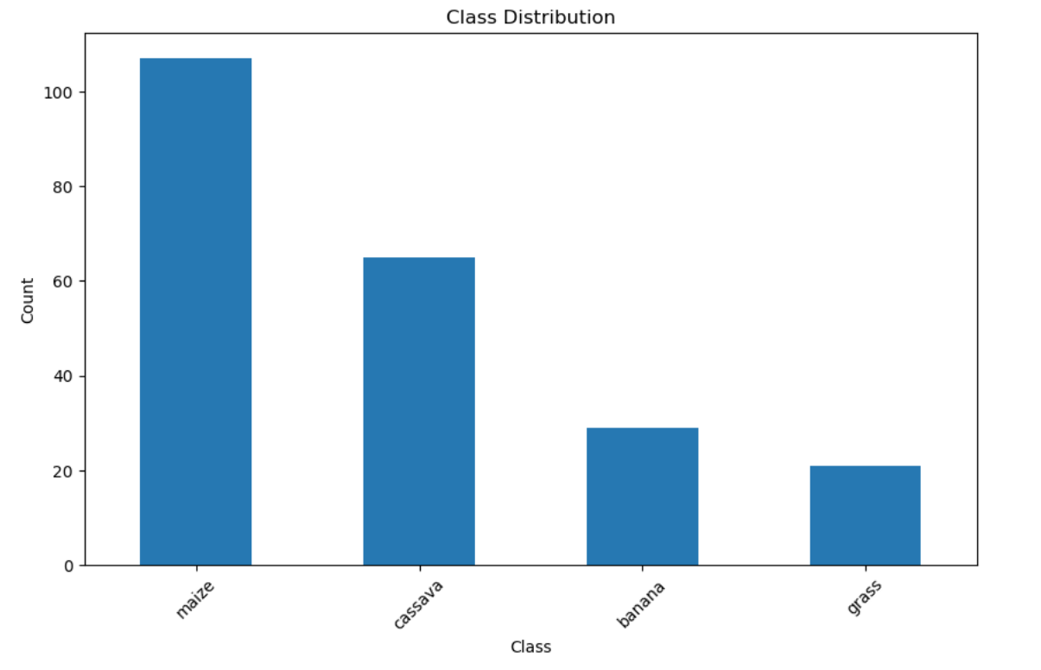
Class Distribution
Under this we focus on distributing different classes with their dataset count shown below;

Slide 10
Data Splitting and Normalization
We performed data splitting and normalization which is done to standardize the dataset and avoid overfitting and fasten the processing.
Normalized training features shape: (177, 512)
Normalized testing features shape: (45, 512)

Slide 11
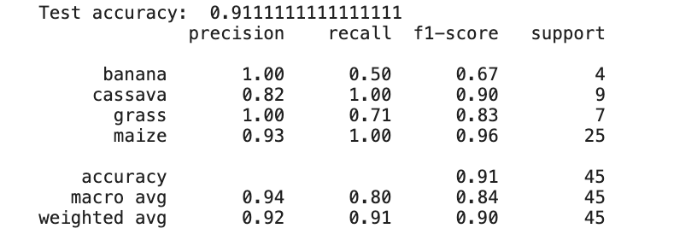
Classification and Results Interpretation
The outcome of our classification is shown below;

Slide 12
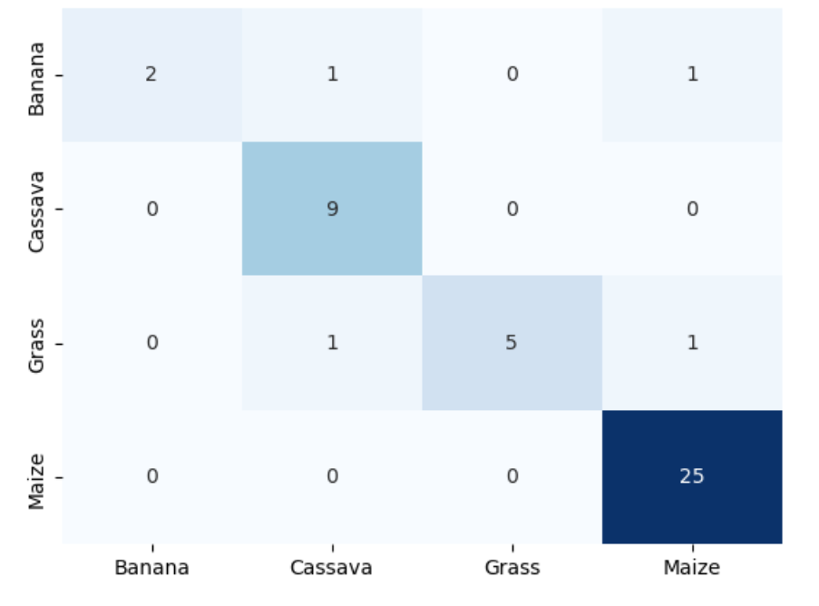
Classification and Results Interpretation
We perform the classification using the KN classifier and with that the results below were obtained.

Slide 13
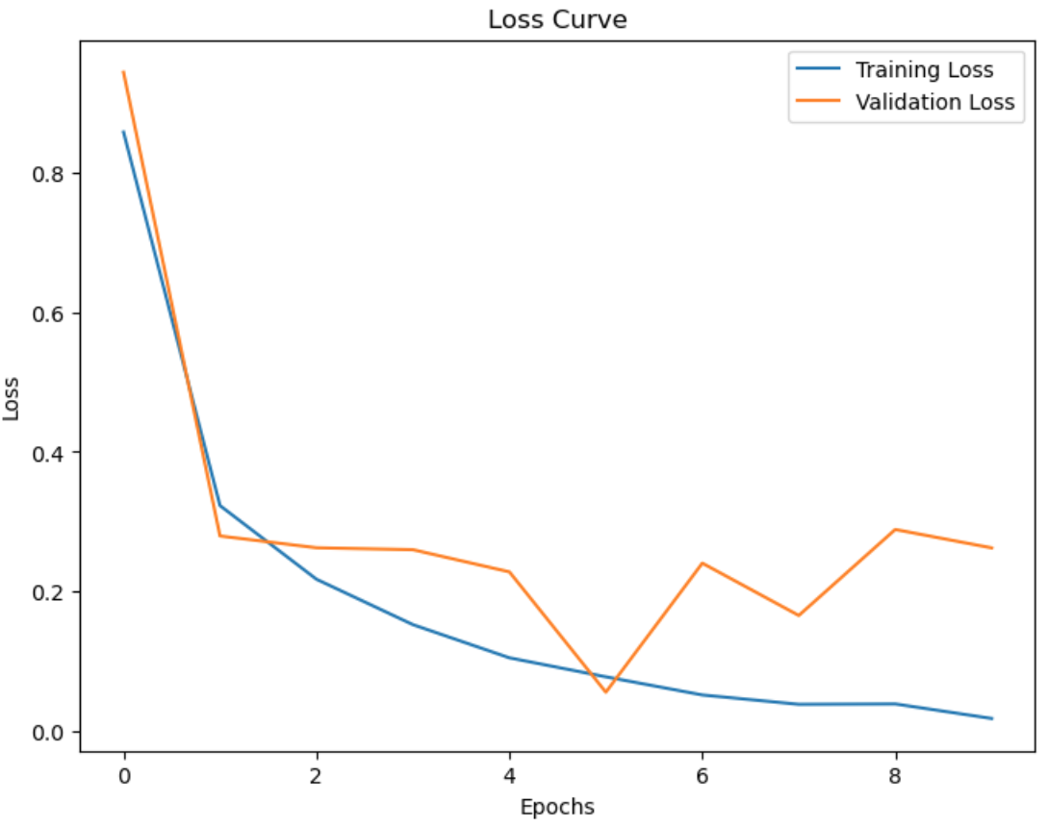
Data Augmentation, Loss and AUC Curve
We performed data augmentation to increase the dataset for better prediction. We then obtained a loss and AUC Curve as seen below;

Slide 14
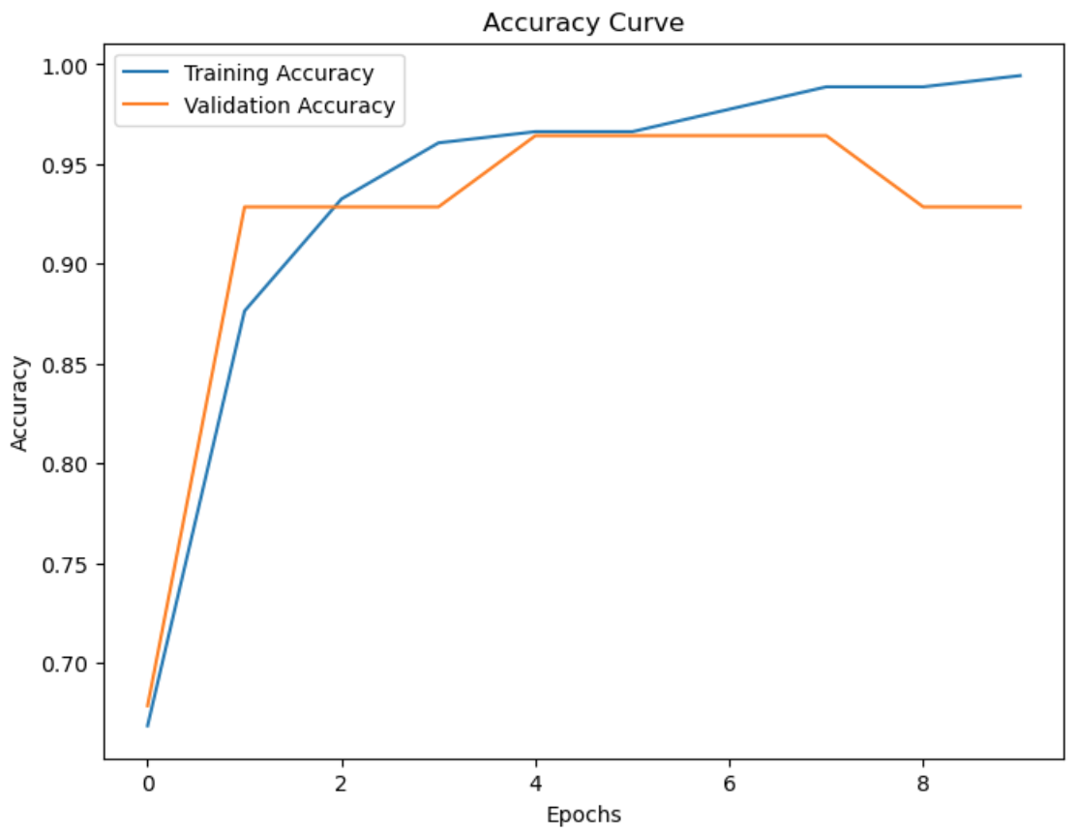
AUC Curve

Slide 15
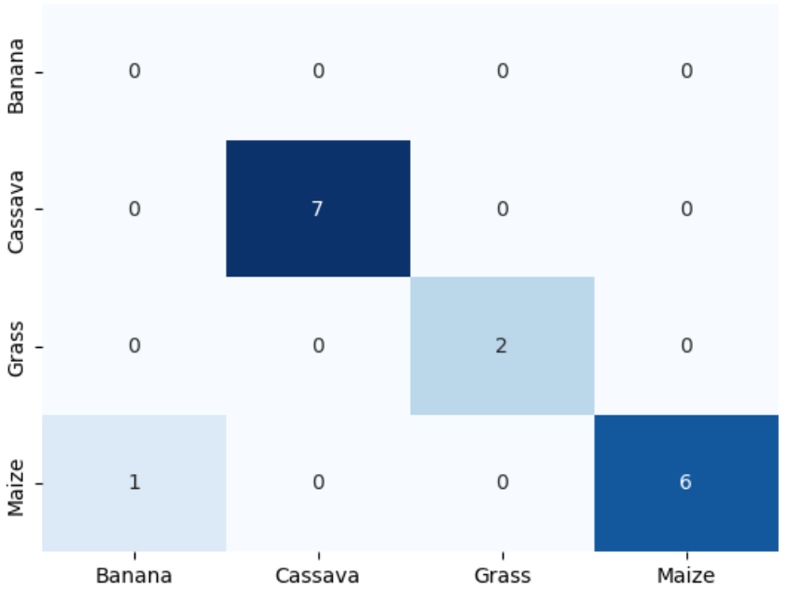
Results Discussion
Using the Exception Model for transfer learning we obtained 94% accuracy and below is our confusion matrix;

Slide 16
Github & Youtube Link
Github: https://github.com/owwilly/oworwilbroad2200701450cvgardentool
Youtube: https://youtu.be/NJN8nXOcJys

